Slide 1
One-Dimensional Continuous Motion
Dr. Jacob Moore
Associate Professor of Engineering
Penn State Mont Alto

Slide 2
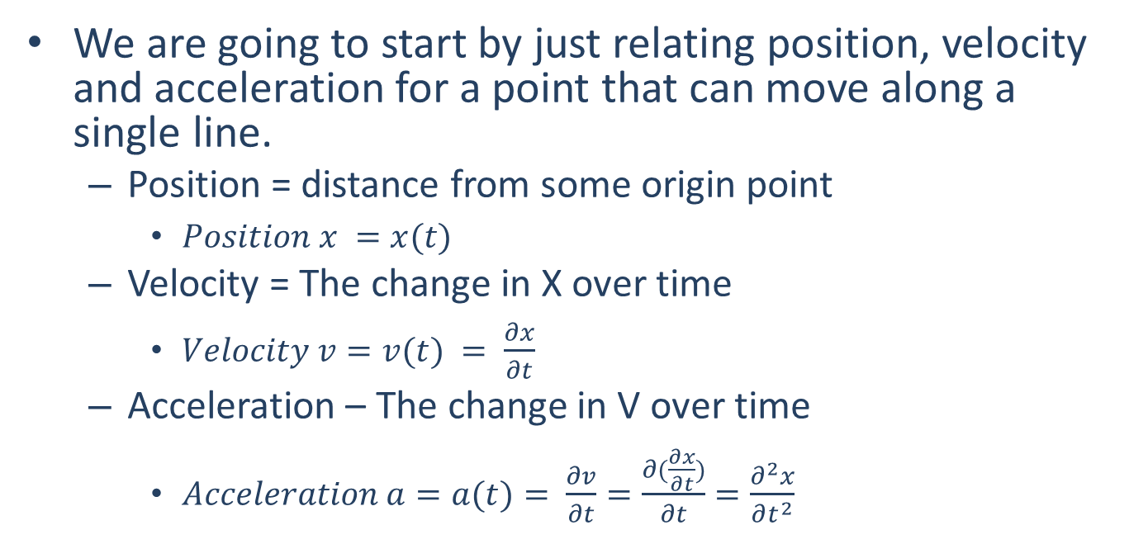
Kinematics
We are going to start by just relating position, velocity and acceleration for a point that can move along a single line.
Position = distance from some origin point
$Position x =x(t)$
Velocity = The change in X over time
$Velocity v=v(t) = \frac{∂x}{∂t}$
Acceleration – The change in V over time
$Acceleration a=a(t)= \frac{∂v}{∂t}=\frac{∂(\frac{∂x}{∂t})}{∂t}=\frac{∂^{2}x}{∂t^{2}}$
p
o
x

Slide 3

Shorthand Symbols
Position : $x(t)$
Velocity : $v\left(t\right)=\frac{dx}{dt}=\dot{x}$(t)
Acceleration : $a(t)=\frac{dv}{dt}=\frac{d^{2}x}{dt^{2}}=\ddot{x}$(t)

Slide 4
Transferring Among Position, Velocity, and Acceleration.
Kinematics problems almost always involve the following process below.
Given that the (position / velocity / acceleration) is described by the function f(t), find it’s (position / velocity / acceleration) over that same time period.
The process of going from one to another is the core of Kinematics.

Slide 5
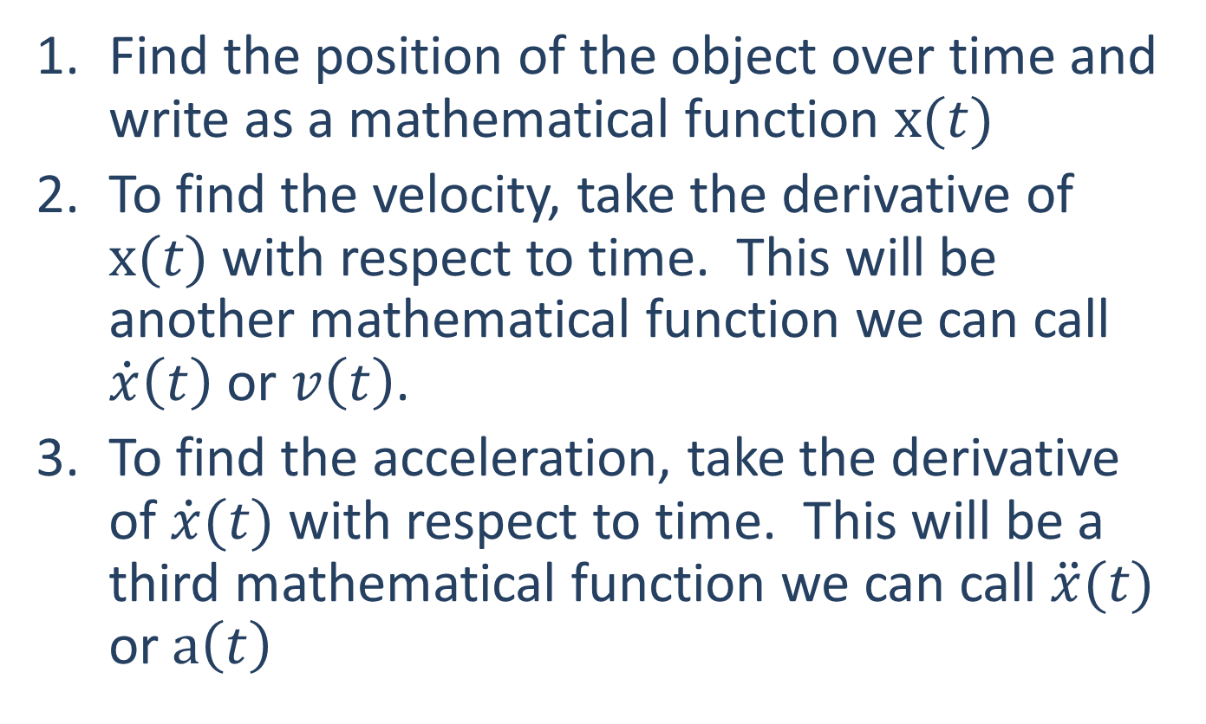
Position → Velocity → Acceleration
Find the position of the object over time and write as a mathematical function $x(t)$
To find the velocity, take the derivative of $x(t)$ with respect to time. This will be another mathematical function we can call $\dot{x}\left(t\right)$ or $v\left(t\right)$.
To find the acceleration, take the derivative of $\dot{x}(t)$ with respect to time. This will be a third mathematical function we can call $\ddot{x}(t)$ or $a\left(t\right)$

Slide 6
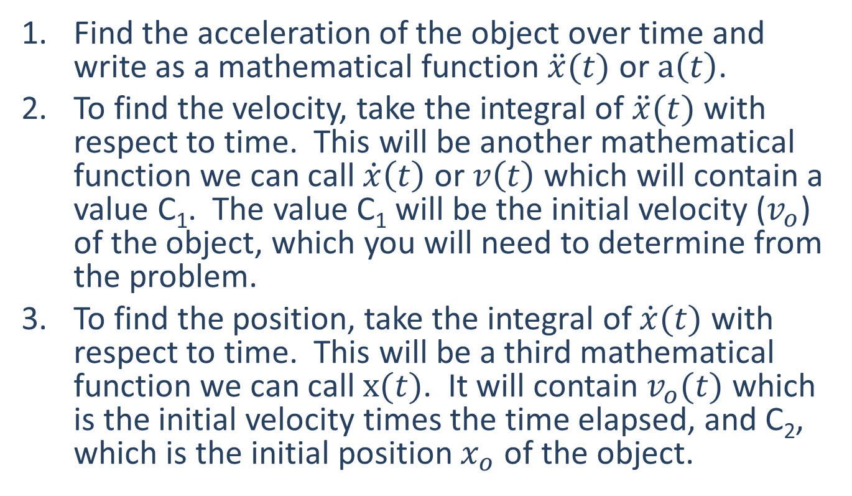
Acceleration → Velocity → Position
Find the acceleration of the object over time and write as a mathematical function $\ddot{x}(t)$ or $a\left(t\right)$.
To find the velocity, take the integral of $\ddot{x}(t)$ with respect to time. This will be another mathematical function we can call $\dot{x}\left(t\right)$ or $v\left(t\right)$which will contain a value C₁. The value C₁ will be the initial velocity ($v_{o}$) of the object, which you will need to determine from the problem.
To find the position, take the integral of $\dot{x}(t)$ with respect to time. This will be a third mathematical function we can call $x(t)$. It will contain $v_{o}(t)$ which is the initial velocity times the time elapsed, and C₂, which is the initial position $x_{o}$ of the object.

Slide 7
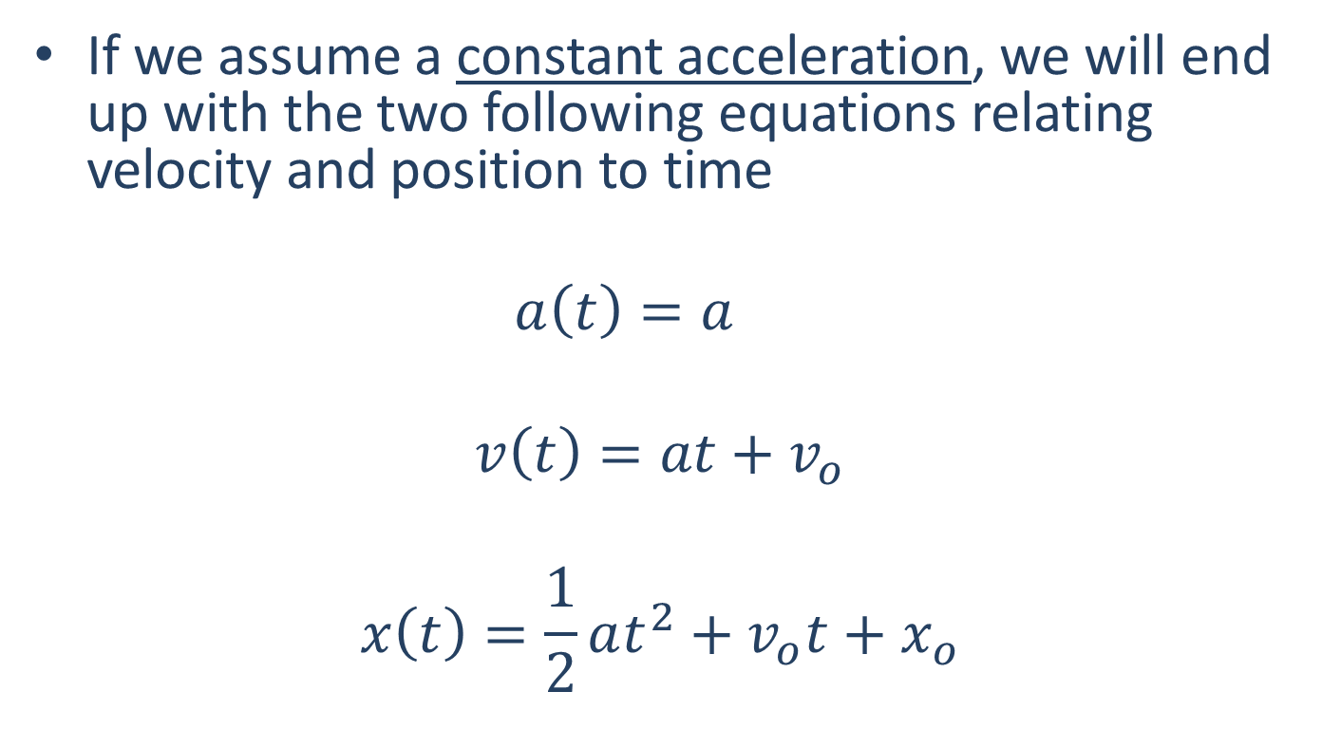
Constant Acceleration Equations
If we assume a constant acceleration, we will end up with the two following equations relating velocity and position to time
$$a\left(t\right)=a$$
$$v\left(t\right)=at+v_{o}$$
$$x\left(t\right)=\frac{1}{2}at^{2}+v_{o}t+x_{o}$$

Slide 8
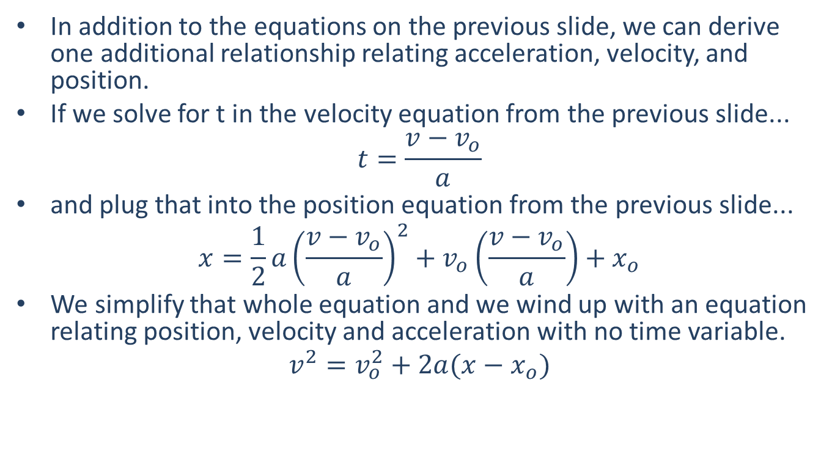
Constant Acceleration Equations
In addition to the equations on the previous slide, we can derive one additional relationship relating acceleration, velocity, and position.
If we solve for t in the velocity equation from the previous slide...
$$t=\frac{v−v_{o}}{a}$$
and plug that into the position equation from the previous slide...
$$x=\frac{1}{2}a{\left(\frac{v−v_{o}}{a}\right)}^{2}+v_{o}\left(\frac{v−v_{o}}{a}\right)+x_{o}$$
We simplify that whole equation and we wind up with an equation relating position, velocity and acceleration with no time variable.
$$v^{2}=v_{o}^{2}+2a(x−x_{o})$$

Slide 9
Thanks for Watching
See other engineering mechanics videos and access the full tool at…

Slide 10

Worked Example
You are in a van that steadily accelerates from 20 m/s to 35 m/s over the course of 10 seconds. What is the rate of acceleration?

Slide 11
Worked Example
You are in a van that steadily accelerates from 20 m/s to 35 m/s over the course of 10 seconds. How far did you travel in meters over the course of those ten seconds?

Slide 12
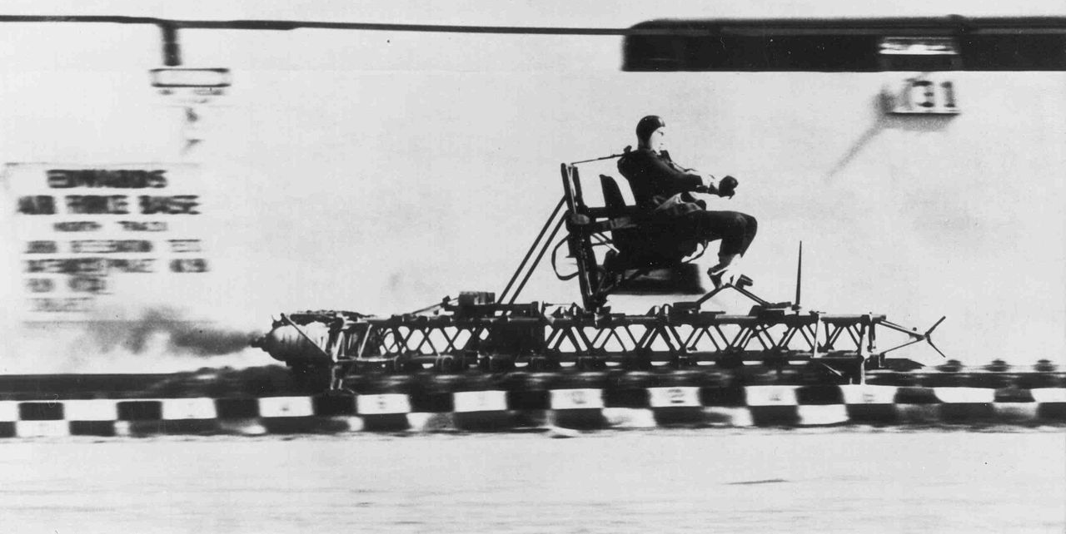
Worked Example
In a rocket sled deceleration experiment, a manned sled is decelerated from a speed of 200 mph (89.4 m/s) to a stop at a constant rate of 18 Gs (176.6 m/s²).
How long does it take for the sled to stop?
How far does the sled travel while decelerating?

Slide 13
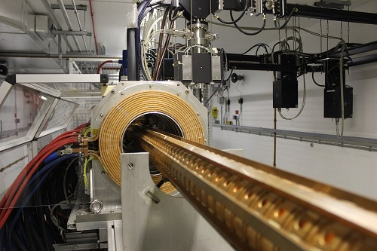
Worked Example
A metallic particle is accelerated in a magnetic field such that its velocity over time is defined by the function v(t) = 4t² - 12, where time is in seconds and velocity is in meters per second. If we assume that the particle has an initial position of zero (x₀ = 0), what are the equations that describe the acceleration and position over time?

